Slide 1
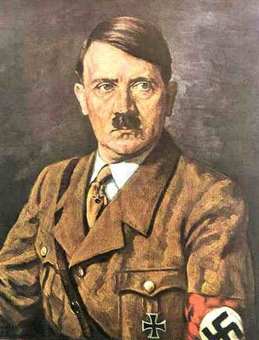
World War II

Slide 2
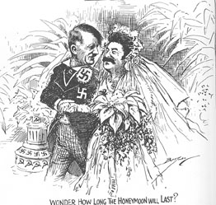
August, 1939 Hitler and Stalin sign the Nazi-Soviet Non-Aggression Pact
This frees up Germany from fighting a two-front war

Slide 3
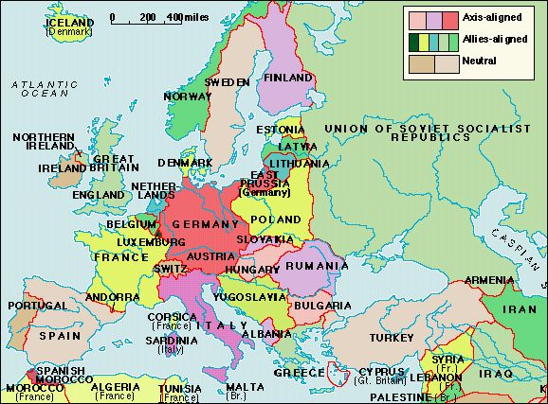

Slide 4
Germany Invades Poland!
Sept. 1, 1939 – World War II officially begins - GBR and FRA declare war on GER soon after
Where’s the United States???
Army of 185, 000
Less than $500 million defense budget
No entangling alliances
No troops stationed on foreign soil
Deep isolationist mood
FOCUS IS ON THE ECONOMY
Americans are split:
ISOLATIONISTS:
Resisted any steps to get involved. Did not want to get dragged into another European conflict
INTERVENTIONISTS: Wanted to abandon neutrality and give military aid to GBR and FRA

Slide 5
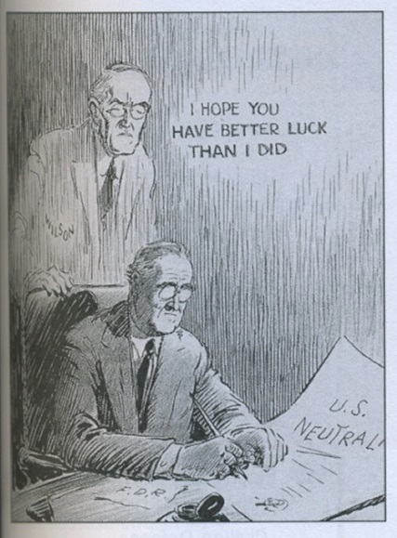

Slide 6
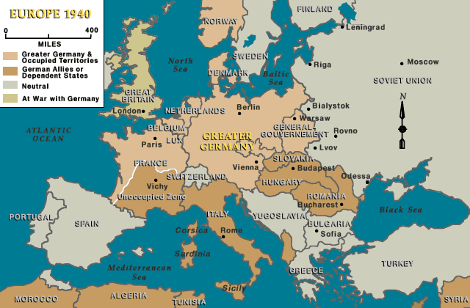
“The Great Arsenal of Democracy”
November 1939 –
Asks for a repeal of arms embargo
Cash n’ Carry approved
“The best defense for the United States is the best defense of Europe!”
Less than a year later, the German blitzkreig has toppled - in addition to Poland - Norway, Denmark, Belgium, The Netherlands, Luxembourg and moves deep into France
By the end of June, 1940, France surrenders to the Nazis

Slide 7
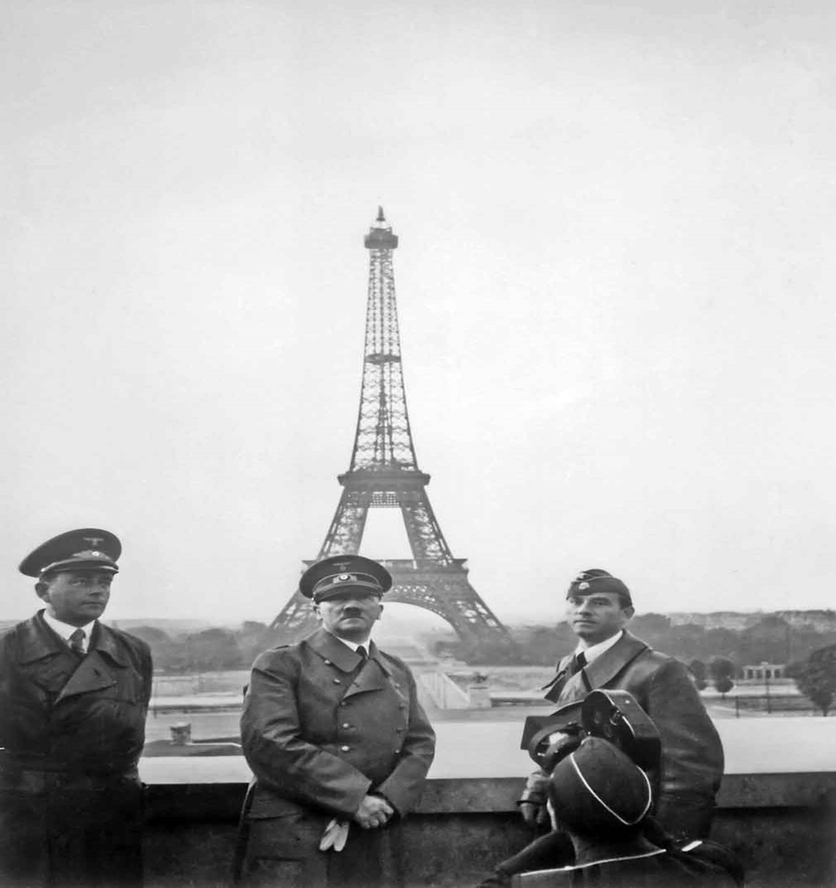

Slide 8
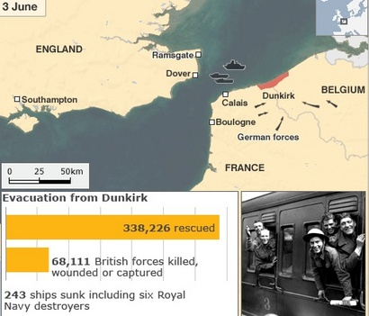
Miracle at Dunkirk

Slide 9
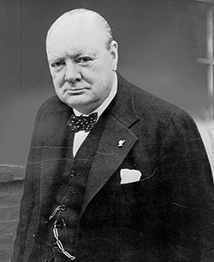
Winston Churchill
“England’s Greatest Weapon”
Rallied his people against a Nazi invasion that was sure to come

Slide 10
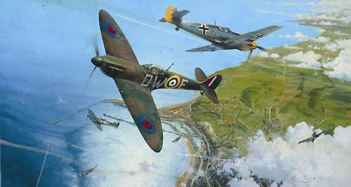
Battle of Britain
With all of mainland Europe under his control, Hitler sets his sights on the British Isles and launches Operation: Sea Lion (invasion of Britain)
RAF vs. Luftwaffe

Slide 11
London Blitz

Slide 12
London Blitz
While Londoners fled underground each night for safety, Churchill could be heard on the radio rallying his people “never to surrender”

Slide 13
Meanwhile…
Sept. 1940: “Bases for Destroyers” - US gives 50 outdated battle ships for 99 year leases on bases in Guiana and Bermuda
Dec. 1940: GBR broke, can’t afford Cash n’ Carry. FDR proposes LEND-LEASE (Congress approves it 1941)
US Navy is convoying GBR ships AND reporting location of GER submarines (FDR was hoping for GER attack, to be drawn into European war

Slide 14
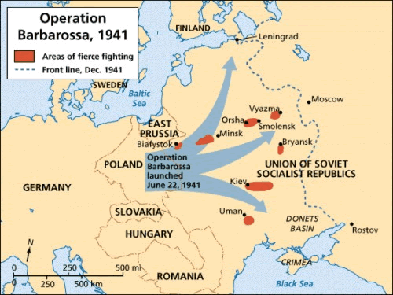
Operation Barbarossa
June 1941 – Hitler, growing impatient with the failed invasion of GBR, turns his attention East, and invades the USSR

Slide 15
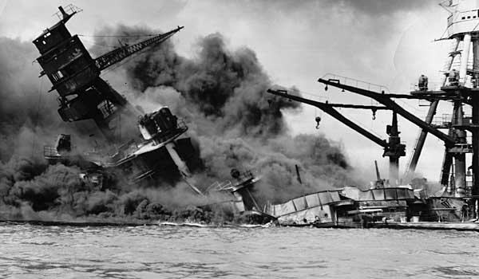
“A Date Which Will Live in Infamy…”
December 7th, 1941: Japanese surprise attack Pearl Harbor, Hawaii (US declares war the next day)

Slide 16
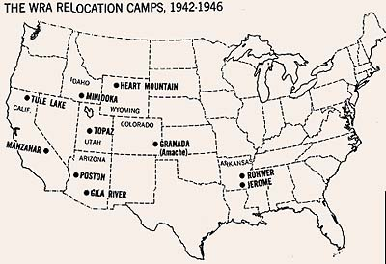
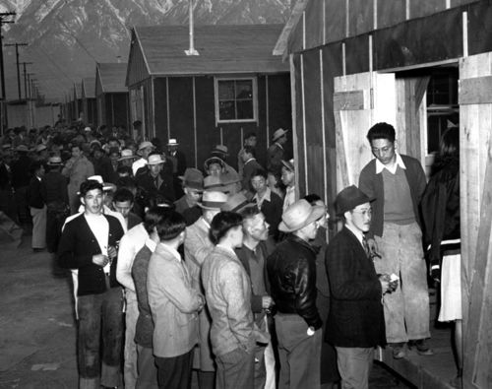
Executive Order 9066

Slide 17
On a side note…
Atlantic Charter signed – August 1941
Axis : Germany, Italy, Japan
Allies: US, GBR, USSR
Charles De Gaulle leading the French Government in exile (“The Free French” are using guerrilla tactics in Nazi Occupied France)
Stalin wants US and GBR to invade France and open a second Western front to relieve the pressure on his army in the East

Slide 18
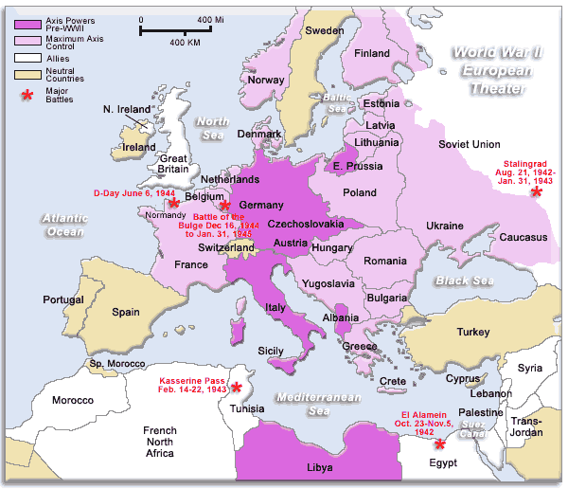
Operation TORCH
GBR wanted a strong Mediterranean presence
US wanted relatively quick and easy entrance to the war to boost morale and support at home
Allies could use North African Invasion as a springboard into Italy, then Germany

Slide 19
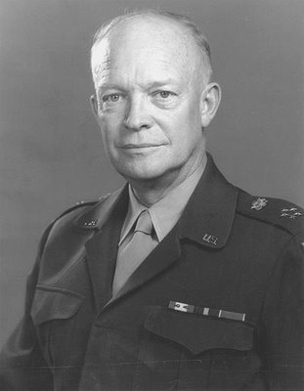
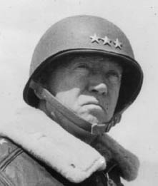
General Dwight Eisenhower and General George Patton would play significant roles in leading the invasion and commanding tank warfare in the desert terrain

Slide 20
War At Home Total War is Back!
Selective Service Act
Factories convert to war goods
Goods were rationed
Prices and wages set by the government
War bonds were sold
HUGE propaganda campaign by the government to urge participation

Slide 21
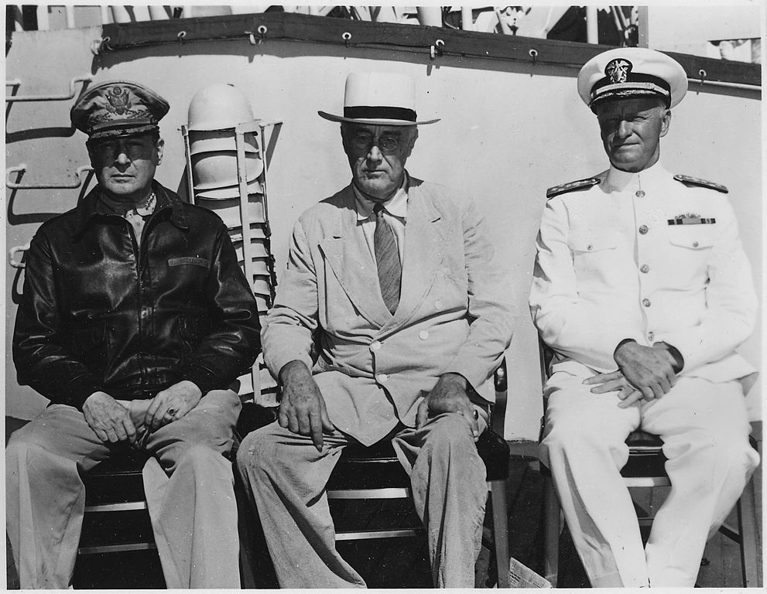
Out in the Pacific…
Battle of Coral Sea (prevents any further Japanese expansion southward, also protected Australia)
Battle of Midway (protected Hawaii, stopped Japanese advance eastward)
Battle of Guadalcanal (First American Offensive)
General Douglas MacArthur, commander of Armed forces in Pacific w/ President Roosevelt and Admiral Chester Nimitz, commander of all Naval Forces begin ISLAND HOPPING campaign by 1943

Slide 22
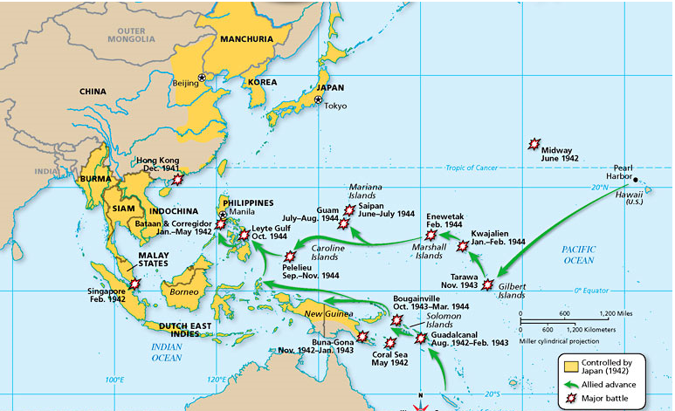

Slide 23
Back in Europe…
Operation Barbarossa’s turning point is Stalingrad - Soviet Red Army begins to push the Nazis West
Mussolini is overthrown and murdered
Allied forces led by the US, liberate Italy
By 1945, Italy was run by a council of Allied Powers – USSR NOT a part of it! ***Stalin would use this precedent when dealing w/ Eastern European lands his army liberates from Nazis
Gen. Eisenhower is made Supreme Leader of All Allied Forces in Europe and preparations are begun for the largest amphibious landing ever – OPERATION OVERLORD (D-DAY) 5000 ships
6000 airplanes 175,000 troops

Slide 24
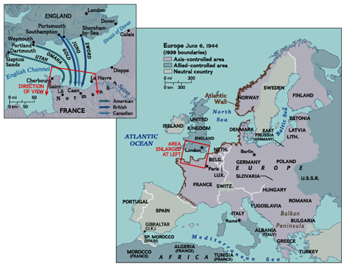
D-Day (June 6, 1944)

Slide 25
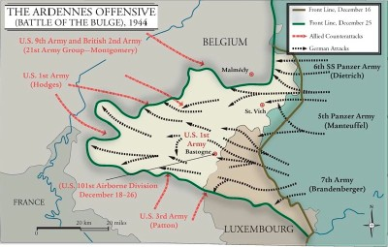
Battle of the Bulge December 1944
Hitler orders a last offensive in an attempt to break the Allies line of advance in the Ardennes Forest in Belgium…it failed.

Slide 26
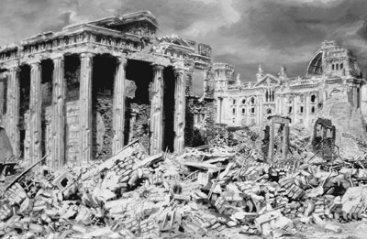
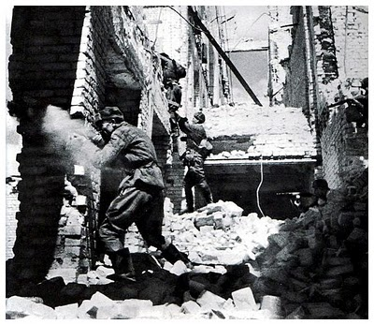
On to Berlin!
With the walls closing in around him, Hitler buries himself beneath the Reichschancellory in an underground bunker…The Red Army begins to shell the city…
After intense building to building combat, Hitler commits suicide on April 30th 1945 and the Germans surrender about a week later…May 7th (V-E Day)

Slide 27
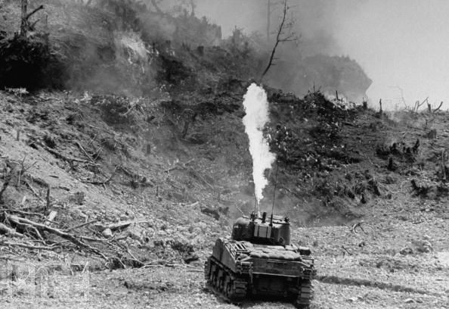
In the meantime…
As Allied troops got closer to mainland Japan, fighting got more ferocious: Iwo Jima Okinawa
Japanese soldiers fought out of underground tunnels, and refused to surrender…

Slide 28
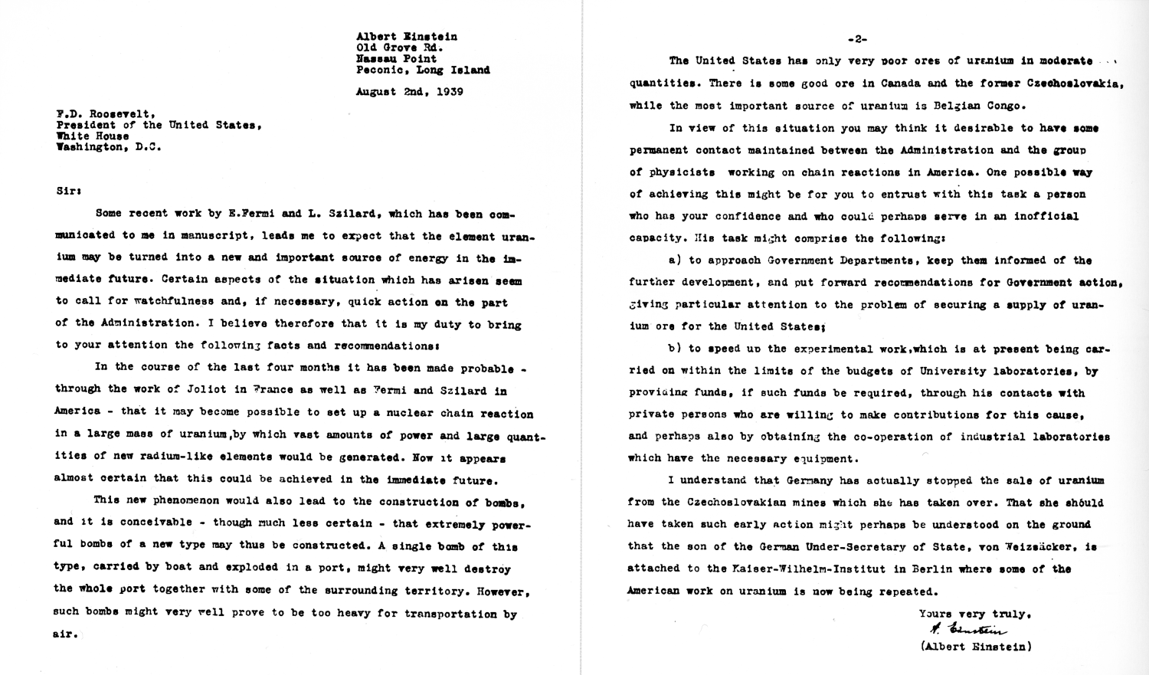

Slide 29
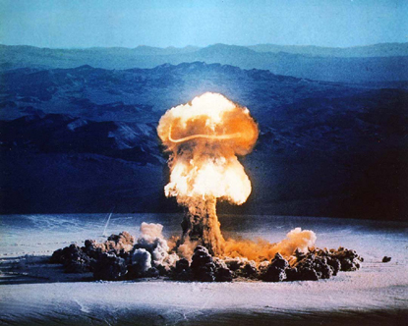
The Manhattan Project
Top Secret project to develop an atomic bomb got the green light in 1939 after Albert Einstein warned FDR
Robert Oppenheimer led the project
Testing facility in Los Alamos, New Mexico
July 16, 1945 – SUCCESS!
August 6, 1945: Hiroshima August 9, 1945: Nagasaki August 14, 1945: Japan Surrenders unconditionally (V-J Day)

Slide 30
Decision to Drop the Bomb
1) Saved soldiers’ lives (a mainland invasion was estimated to cost 2 million men)
Keep USSR out of Japan
Justify $2 billion price tag
Media: What if??
Showcase to USSR superior firepower for impending Cold War
Revenge for Bataan and other war crimes by Japanese

