Slide 1
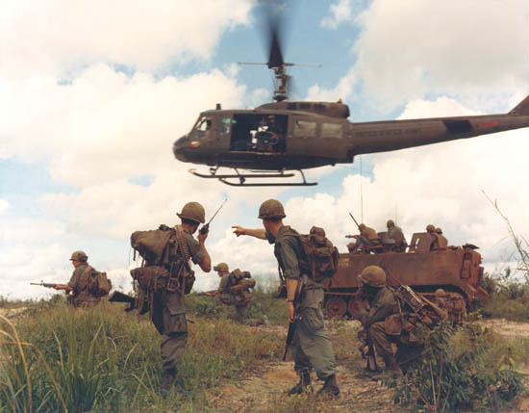
Vietnam War

Slide 2
French Indochina
During World War II, the French colony of Indochina was captured by the Japanese…when the war was over, France sought the return of their colony

Slide 3
Ho Chi Minh
Leader of the Viet Minh, a group whose goal was Vietnamese independence. He had visited the West and looked for any supporters of his cause. Eventually, he embraced communism, and the Soviet Union came calling…

Slide 5
Geneva Accords (1954)
Because they desired a strong anti-communist ally in France, the US sends millions of dollars in aid to the French against the Viet Minh…until the French lose at Dien Bien Phu.
Vietnam is partitioned at the 17th parallel. The North will be under Communist rule with Ho Chi Minh as their leader and the South will be non-Communist, supported by the United States.
A national unification election was to be held within two years…it never does because the US fears a communist victory.

Slide 6
Ngo Dinh Diem
The United States is a strong believer in the DOMINO THEORY: if one Southeast Asian country falls to the communists, like a row of dominoes, they all would, one by one. The United States will support the leadership of Diem in South Vietnam, but the people there will not. He is Catholic in an overwhelmingly Buddhist country, and his corruption and policies hindered progress.

Slide 7
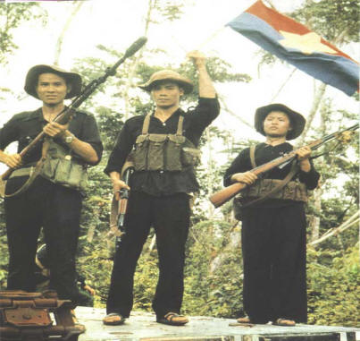
Viet Cong
Guerrilla force that fought the South Vietnamese and American armies in the South while attempting to recruit the South Vietnamese peasants to join the Communists. They are NOT members of the North Vietnamese Army (NVA). They are ordinary people by day, guerrillas by night and integrate with the South Vietnamese population. Determining who is a Viet Cong (VC) and who is not is virtually impossible in the villages of South Vietnam.

Slide 8
Strategic Hamlet Program

Slide 9
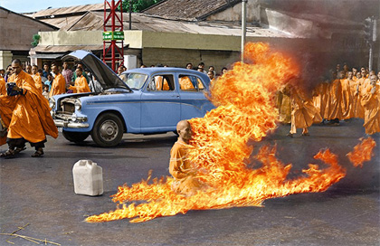

Slide 10
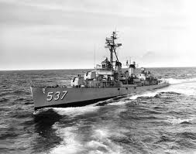
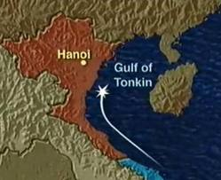
Gulf of Tonkin Incident
Aug. 2, 1964: The USS Maddox is fired upon while patrolling North Vietnamese waters.

Slide 11
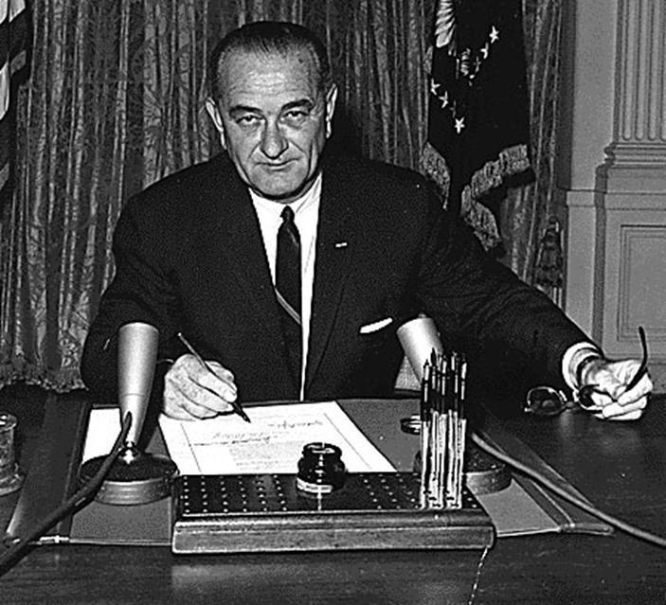
Gulf of Tonkin Resolution
With only two dissenting votes in Congress, LBJ gets a virtual blank check to “take all necessary measures to repel any armed attack against the forces of the United States and to prevent any further aggression.” He can and will escalate the war and doesn’t have to ask Congress for permission for anything.

Slide 12
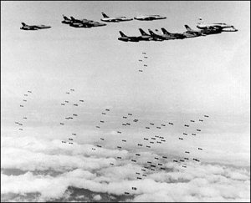
Gen. William Westmoreland
Feb. 1965: Operation Rolling Thunder was the first heavy bombing of North Vietnam. By June, there will be 50,000 US combat troops on the ground. By 1966, the US was performing “Search and Destroy” missions.
The American commander in South Vietnam, he urged LBJ to increase American responsibility in the war.

Slide 13
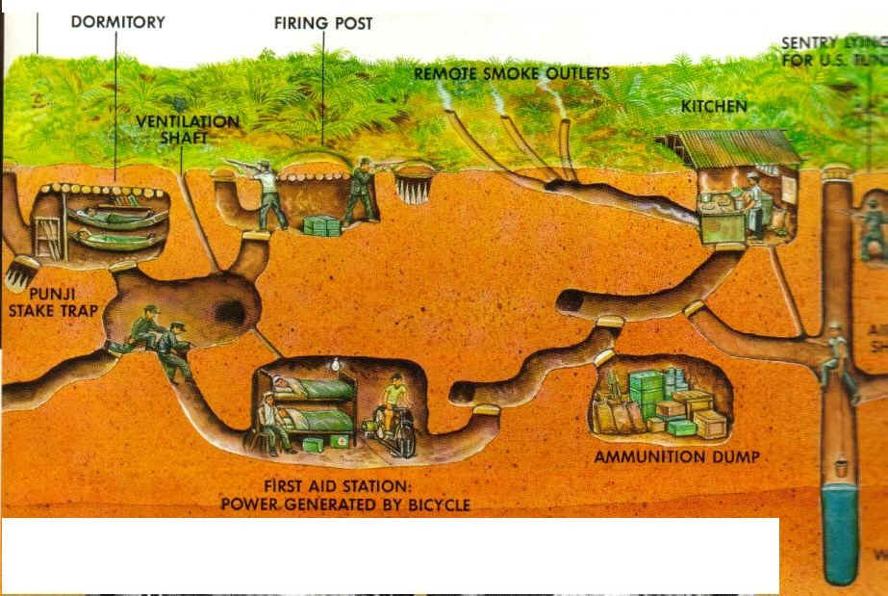
Vietnamese Tunnel System

Slide 14
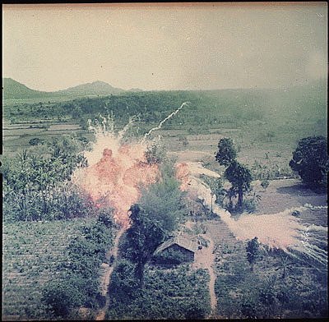
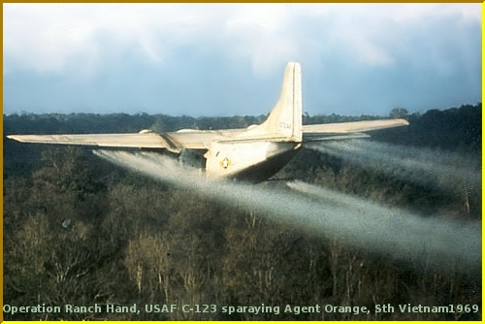
Napalm and Agent Orange
Agent Orange was a chemical sprayed on the jungle to expose the enemy’s hiding places and kill its food supply
Napalm is a highly flammable, jellylike substance dropped on enemy positions. It clung to anything and was difficult to extinguish

Slide 15
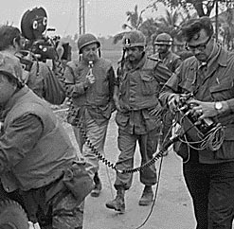
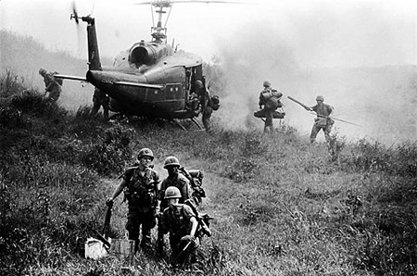
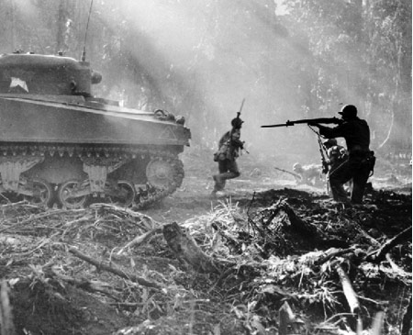
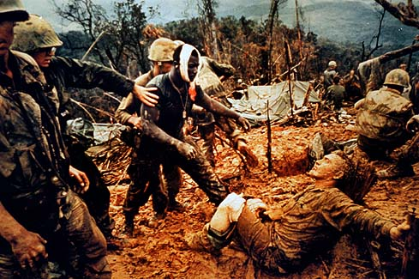
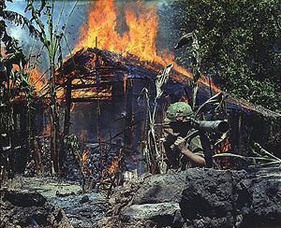
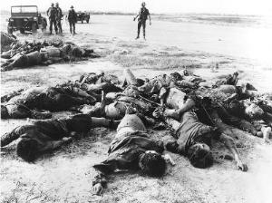
“America’s Living Room War”
Reporters were permitted wide access to all aspects of the war. Because of this, there was a growing Credibility Gap between what the government was saying and what people saw on TV.

Slide 16
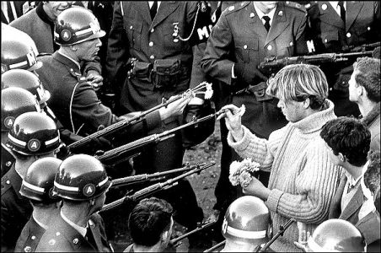
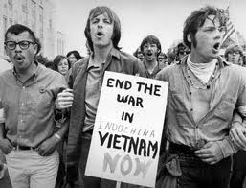
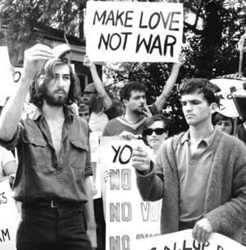
Roots of Opposition
Credibility Gap
Waste of resources
Vietnamese Civil War
Inhumane killing (napalm, civilians)
Unfair lottery system (*deferments)
“Poor man’s War”
Morally unjust
Most that were drafted couldn’t vote

Slide 17
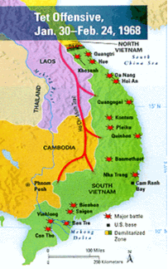
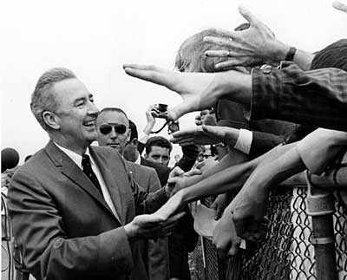
Tet Offensive
From 1965 – 1967, LBJ kept insisting that we were winning the war and that the enemy was weakening…then came Tet.
Communists launch surprise attacks all throughout the South and overwhelms them. After this, most in US feel war cannot be won…
Eugene McCarthy’s anti-war message is gaining momentum as he challenged LBJ for the Democratic nomination for president in 1968.

Slide 18
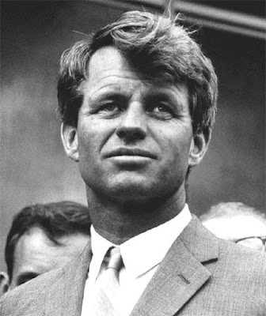
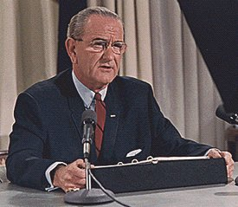
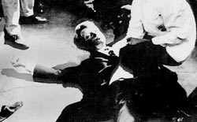
March 31, 1968: LBJ announces he will not seek re-election. This allows RFK to announce his anti-war candidacy shortly thereafter…but he is assassinated in June after winning the California primary.

Slide 19
1968 Election
Republican – Richard Nixon (original cold warrior, anti-communist, wants to win in Vietnam
Democrat – VP Hubert Humphrey (would continue LBJ’s war policies if elected)
Independent – George Wallace (wanted to bomb the Vietnamese into the stone age!)

Slide 20
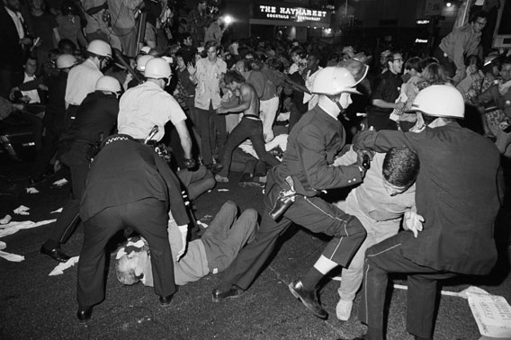
1968 Democratic Convention in Chicago

Slide 21
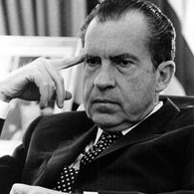
Richard Nixon
Claiming to have a “secret plan” to end the Vietnam War, he appeals to what he called “The Great Silent Majority”
After narrowly winning the 1968 Presidential election, he announces a policy of “Vietnamization”, while increasing bombings of the North
To cut off communist supply lines in the South, he orders secret bombings of Cambodia

Slide 22
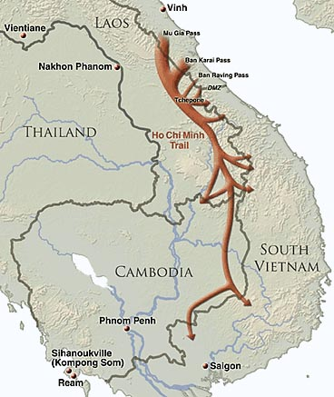
Ho Chi Minh Trail

Slide 23
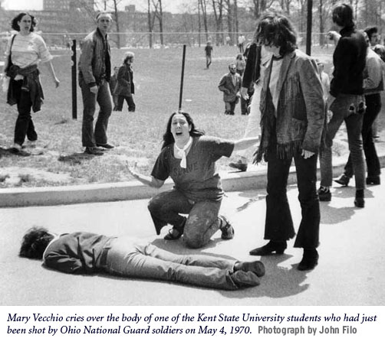
Kent State

Slide 24
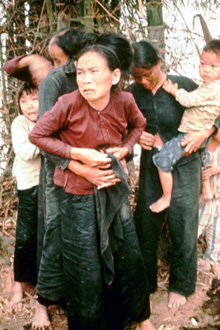
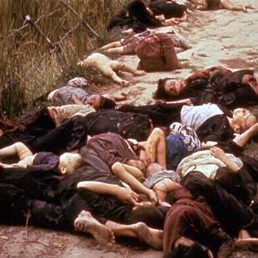
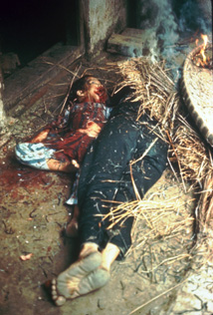
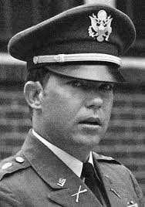
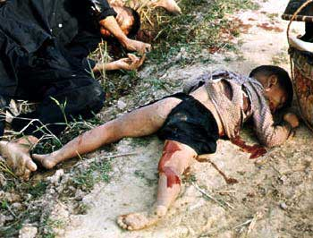
My Lai Massacre
In March, 1971, an investigation leads to the trial of Lt. William Calley in which it is revealed that in 1968, the village of My Lai was liquidated of 300 old men, women, and children…only Calley stood trial for unlawful killing.

Slide 25
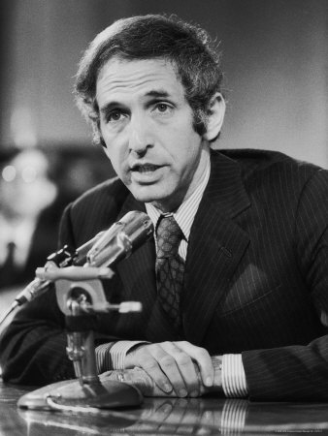
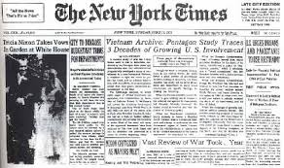
Pentagon Papers
June, 1971: Daniel Ellsberg leaks top secret Vietnam Era documents to the NY Times

Slide 26
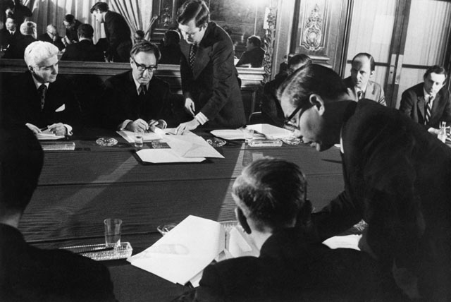
Paris Peace Accords
With US casualties mounting and increased pressure at home, Nixon had Henry Kissinger (Sec. of State) meet with North Vietnamese officials in Paris to finalize the details of the Paris Peace Accords. The agreement was signed on Jan. 27 and went into effect immediately

